Slide 1
The Conversion of Saint Paul the Apostle
Spring Term 2022 Week 3

Slide 2
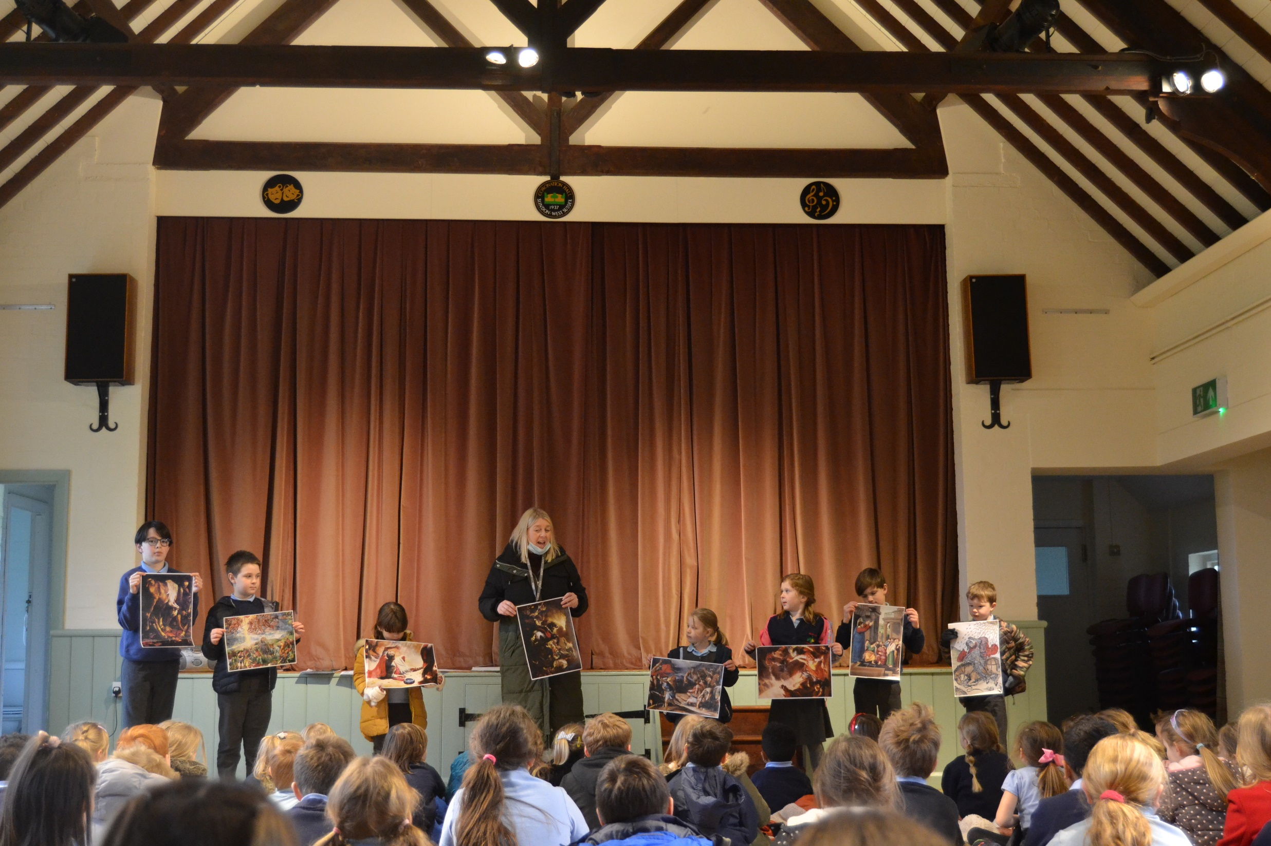
The Conversion of Paul the Apostle- 25th January 2022
Miss Cooper began Collective Worship on Monday with some special pieces of Art. These paintings all depict the conversion of St Paul.

Slide 3
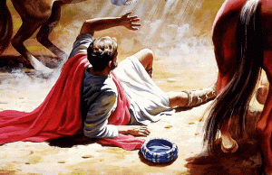
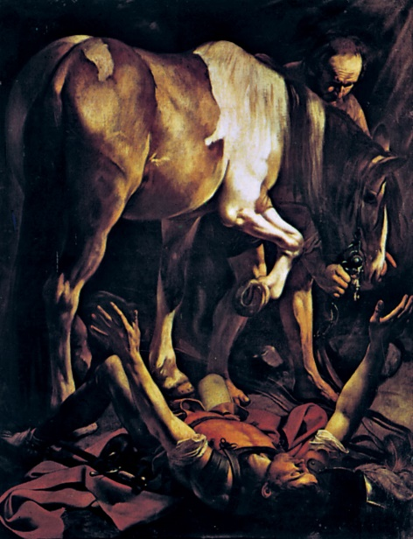
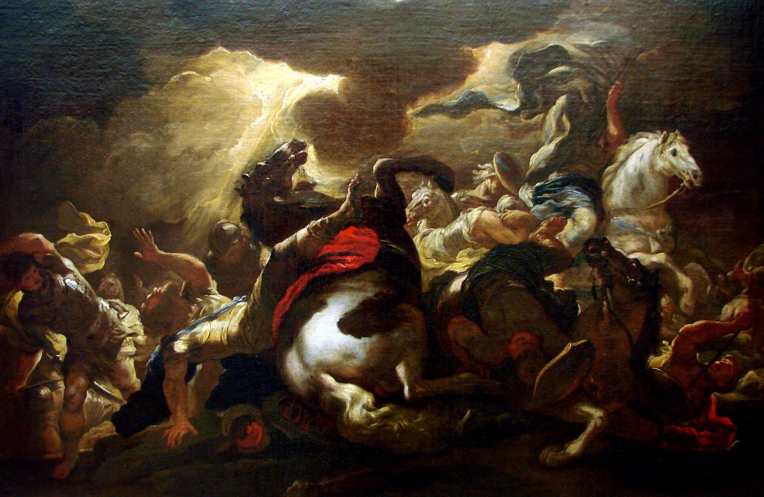
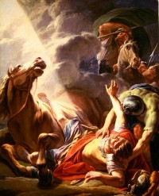
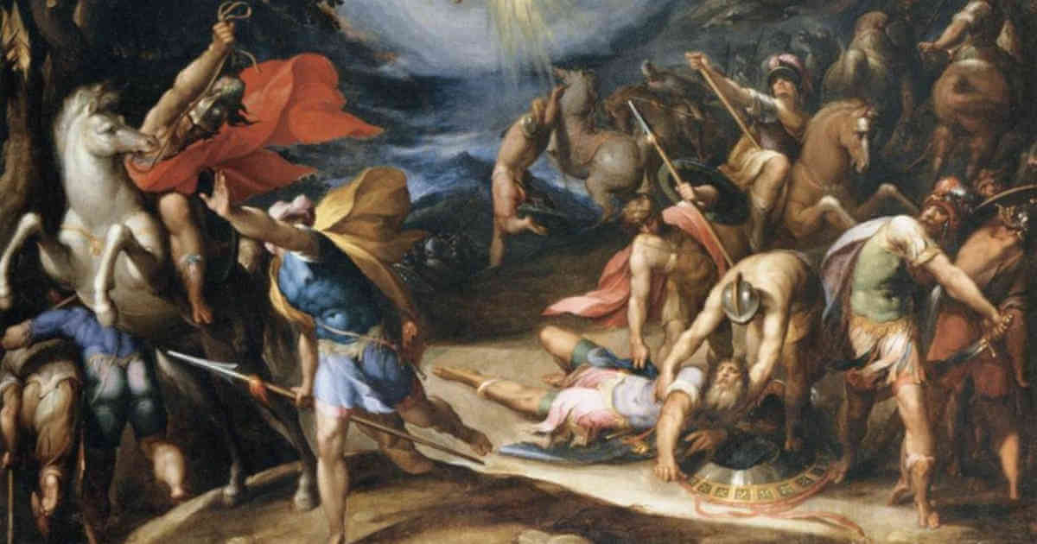
We looked at the art and spoke about common themes such as the horse and a bright, shining light.

Slide 4
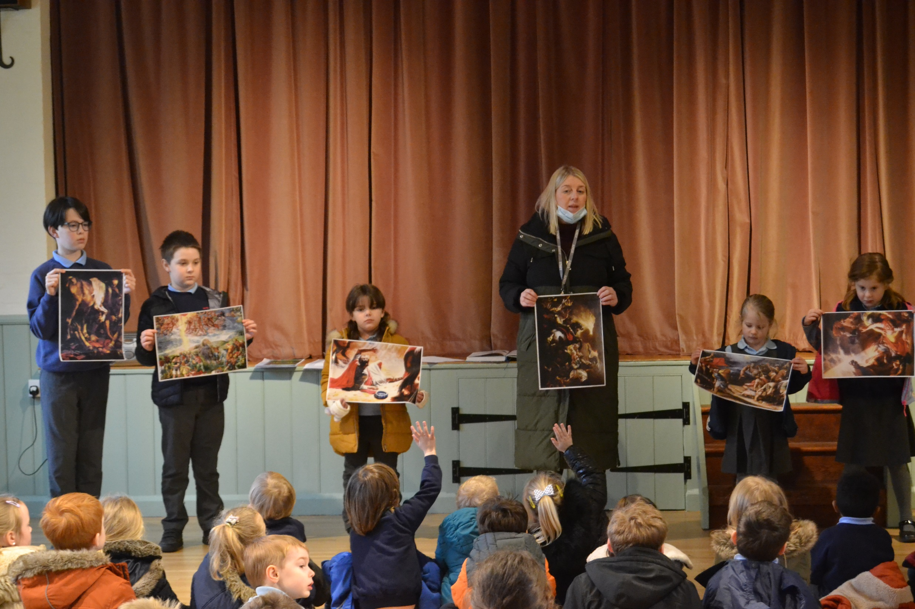
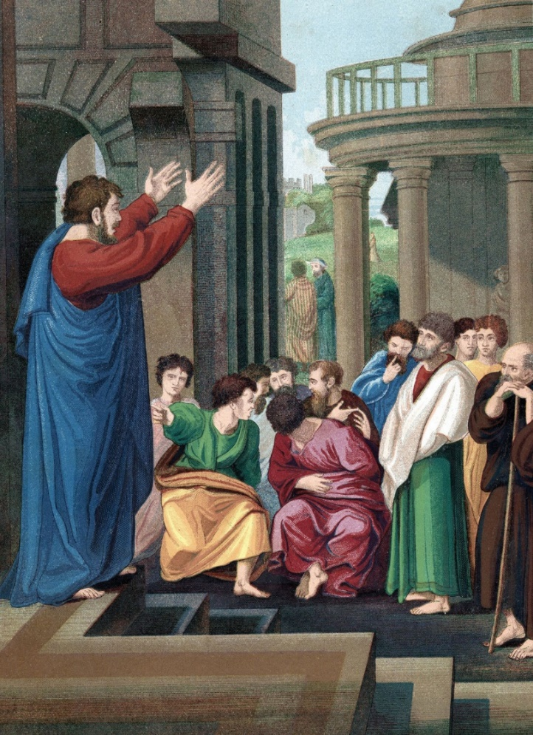
The children enjoyed sharing their responses…
Simona in Year 5 noticed the rays of light- like sunshine.
Isla in Reception, noticed the man’s hands were different in this painting.

Slide 5
Miss Cooper read us the story about the conversion of Saint Paul. We talked about why he is such an important man in Christianity.

Slide 6
Miss Cooper gave us a question to think about over the week…
What does the conversion of Saint Paul make you think about your own life? In the way that you view yourself and in the way that you view others?

