Slide 1
Hugo’s Assembly
Spring Term 2022 Week 2

Slide 2
Matthew Chapter 4 verse 2
Hugo shared a passage from the Bible with us: “Come, follow me,” Jesus said, “and I will send you out to fish for people.”
Chestnuts think Jesus is asking us to follow his example and his way of life.

Slide 3
Acorns class get thinking
How can we sort this muddled verse out?

Slide 4
Chestnut Class get active
I wonder if we are in the right order yet?

Slide 5
We love singing with Hugo!
Our favourite songs are:
By the Spirit of the Lord
I am the Light
Praise ye the Lord

Slide 6
Chestnuts love the actions too!

Slide 7
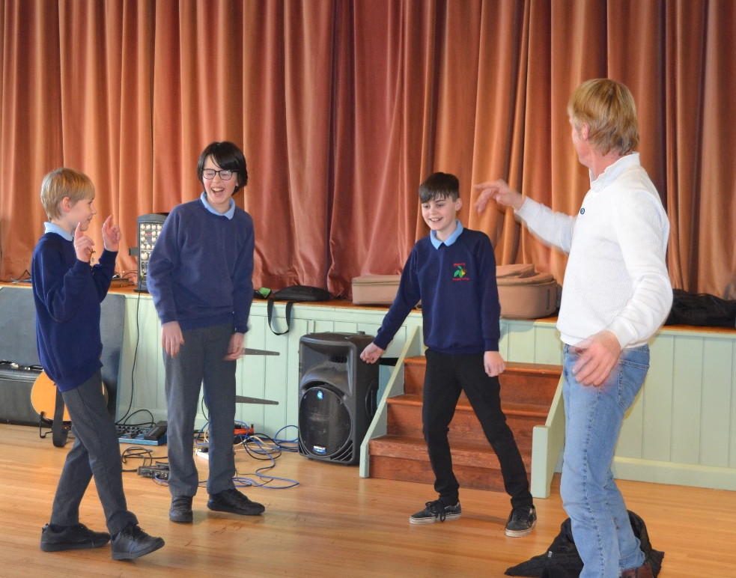
Bible story drama!

Slide 8
Disciples cure a lame man!
The disciples John and Matthew healed a lame man. Some passers-by heard them say to the lame man, “In the name of Jesus, stand up and walk!”
The people were very cross to hear the disciples use Jesus’ name in this way but the disciples were following Jesus’ teachings and example.

