Slide 1
Our Christian Values
Slindon Church of England Primary School

Slide 2
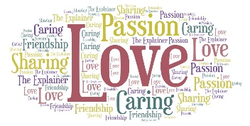
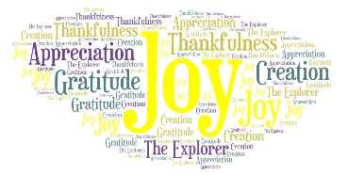
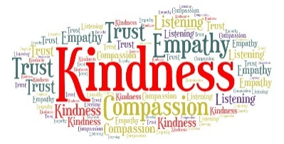
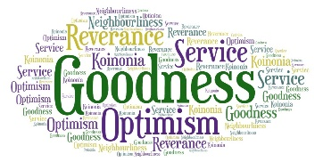
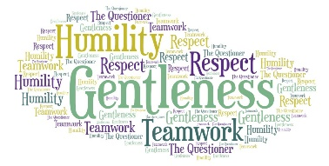
The Fruit of the Spirit is love, joy, peace, patience, kindness, goodness, faithfulness, gentleness and self-control; against such things there is no law.
Galatians 50; 22-23

Slide 3
Our Christian Values
The following slides illustrate how our Christian Values are embedded in our policy within different areas of school life. They are just a few examples taken from;
Our Collective Worship Policy
Our Behaviour Policy
Our Personal, Social, Health and Economic Education Policy (PSHE)
Our Relationship and Sex Education Policy (RSE)
Have a look at the tabs within our ‘Christian Distinctiveness’ tab on our website to see how we are such a special, Christian school.

Slide 4
Collective Worship Policy
As a Christian school, the Christian values that guide us every day are intrinsic to many of our policies, particularly our Collective Worship Policy. Collective worship is central to the life of our school and to its religious character. It is one of the means whereby our Fruits of the Spirit ‘Love, Joy, Peace, Patience, Kindness, Goodness, Faithfulness, Gentleness and Self-Control’, are reflected and affirmed.

Slide 5
Behaviour Policy
As a Christian school, the Christian values that guide us every day are intrinsic to how we behave.
At Slindon Church of England Primary School, we strive to model and demonstrate behaviours inherent within each of the nine ‘blessings’ or fruits of the holy spirit; Love, Joy, Peace,Patience, Kindness, Goodness, Faithfulness, Gentleness and Self-Control;
The Fruit of the Spirit is love, joy, peace, patience, kindness, goodness, faithfulness, gentleness and self-control; against such things there is no law.
Galatians 50; 22-23
We use the fruits of the spirit, along with our Christian values and ‘British’ (although we prefer to call them ‘Human’) values, to guide our behaviour. The blessings guide us in our attitude to God, to other people and ourselves. They sit above and separately to behaviour management, though we are recognised and rewarded for being mindful of the fruits of the spirit and inherent values within each.

Slide 6
PSHE Policy
As a Christian school, the Christian values that guide us every day are intrinsic to many of our policies, including our PSHE Policy. Our Fruits of the Spirit; Love, Joy, Peace,Patience, Kindness, Goodness, Faithfulness, Gentleness and Self-Control, not only guide us in our attitude to God, to other people and ourselves, but are both modelled and explicitly taught within our PSHE curriculum.

Slide 7
RSE Policy
As a Christian school, the Christian values that guide us every day are intrinsic to many of our policies, including our Relationships and Sex Policy. Our Fruits of the Spirit; Love, Joy, Peace,Patience, Kindness, Goodness, Faithfulness, Gentleness and Self-Control, not only guide us in our attitude to God, to other people and ourselves, but are both modelled and explicitly taught within our RSE curriculum.

